Slide 1
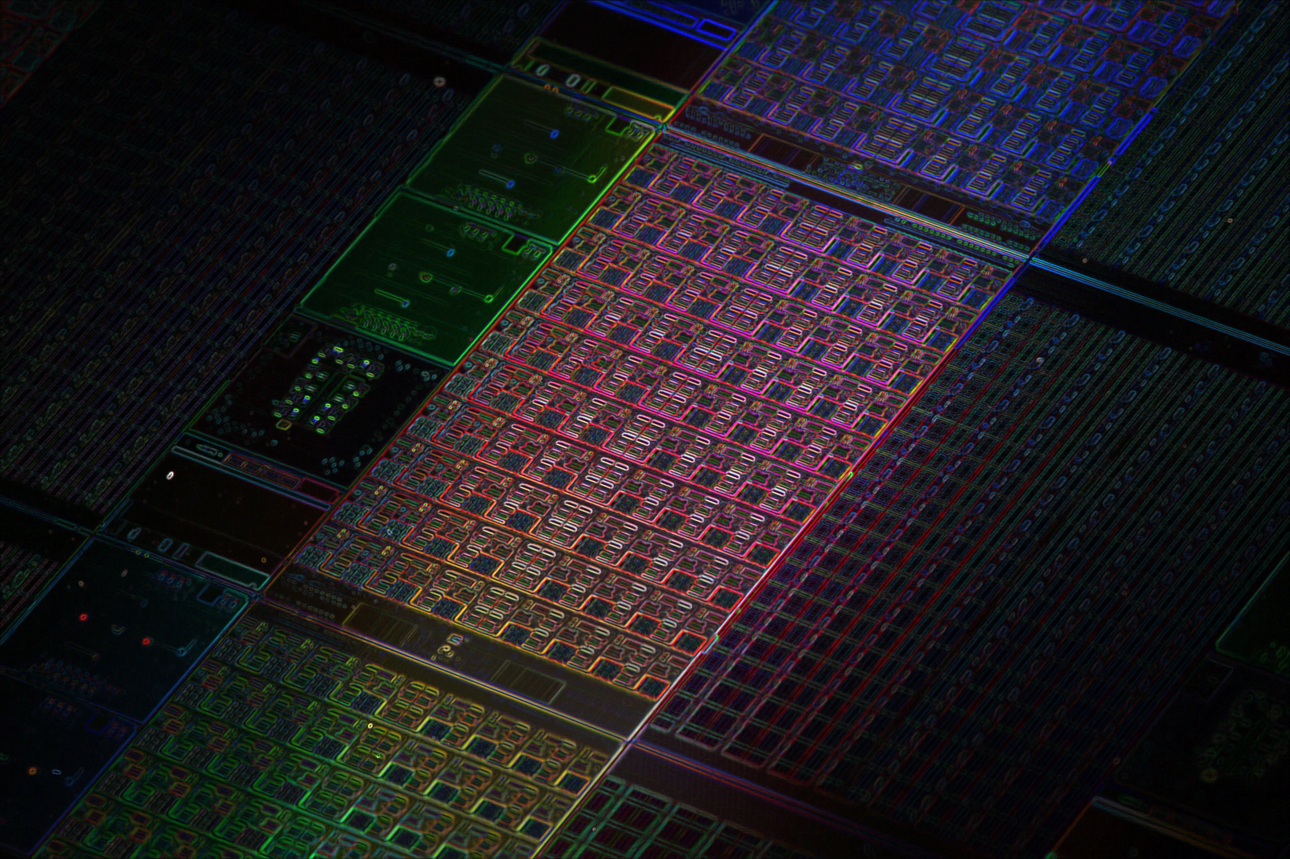

An FPGA-based Accelerator for ShuffleNetV2
Yuhong Li, Ziyan Feng

Slide 2
Outline
System Overview
Acclerator Architecture
Computation Engine
Result
Future Work

Slide 3
System Overview
DRAM
1.SD Card: Store the image and parameters and pass to DRAM
2.ARM CPU: Read parameters and images
Control the Accelerator
Calculate the execution time
3.Accelerator: On PL part, do calculation
AXI HP
SD Card
ARM
CPU
Data
Accelerator
Control
AXI Lite
Zync-7000 Soc

Slide 4
Outline
System Overview
Acclerator Architecture
Computation Engine
Result
Future Work

Slide 5
Accelerator Architecture
Conv(weights, bias, input, output)
Computation
Engine
Feature Map
Buffer 1
Feature Map 1
Feature Map 2
Ping-Pong Buffer
Feature Map
Buffer 2
Weights
Buffer
Bias
Buffer
Accelerator
DRAM

Slide 6
Outline
System Overview
Acclerator Architecture
Computation Engine
Result
Future Work

Slide 7
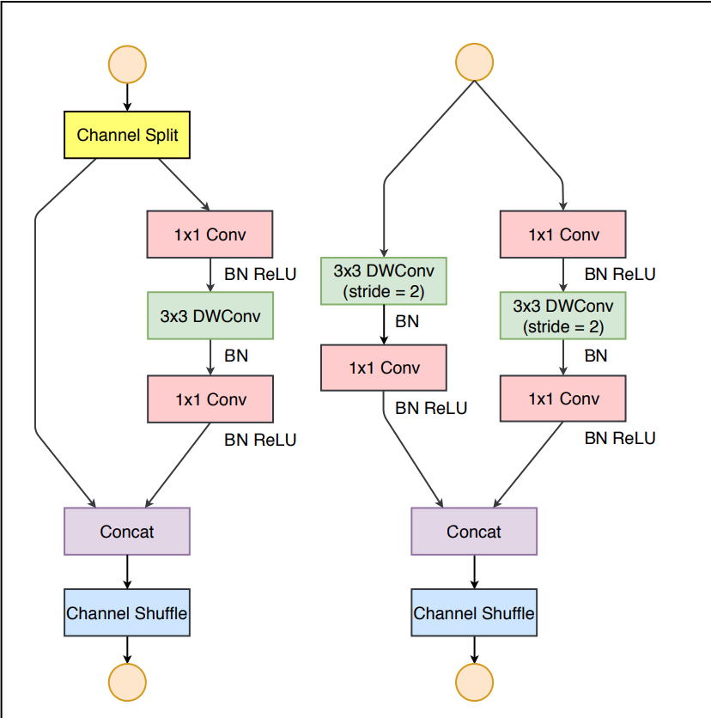
Computation Engine: main structure
a: Basic Unit
b: Downsample Unit
a
b

Slide 8
Computation Engine: Depthwise Conv
N
N
×
M
#pragma array_partition factor = a
#pragma loop unroll factor = a
N Loops -> N/a Loops
M
K
K
N/a

Slide 9
Computation Engine: Pointwise Conv
Using Adder Tree
Calculate one element:
N Loop -> log2(N)
N
P
N×P
×
M
1
1
M

Slide 10
Outline
System Overview
Acclerator Architecture
Computation Engine
Result
Future Work

Slide 11
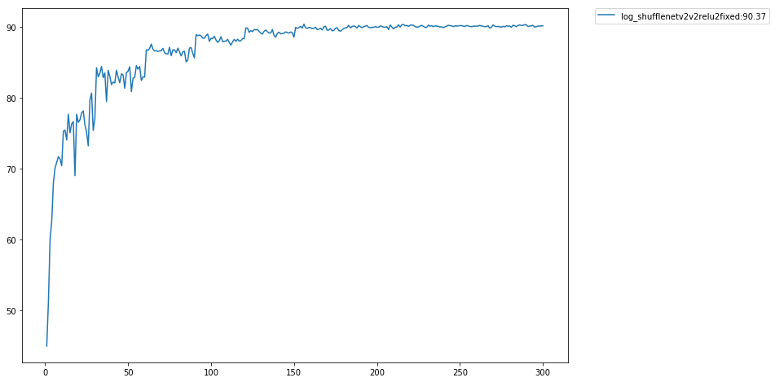
Experiment Result
Testing Accuracy Curve

Slide 12
Experiment Result
weight type | bias type | feature map type | activation type | accuracy | if retrain
floating32 | floating32 | floating32 | ReLU4 | 90.37 | -
fix<1,6> | fix<1,6> | fix<1,6> | ReLU4 | 87.308 | -
fix<1,6> | fix<1,6> | fix<1,6> | ReLU4 | 88.51 | yes

Slide 13
Experiment Result
Resourse | Used | Avaible | Ratio (%)
DSP | 196 | 220 | 89%
BRAM | 268 | 280 | 95%
FF | 80864 | 106400 | 76%
LUT | 37247 | 53200 | 70%
Verion | Time(Cycle)
CPU | 33,860 k
HLS without optimization | 110,591 k
HLS with fixed point | 83,125 k
Final time | 15,143k
Final speedup | 2.236x

Slide 14
Outline
System Overview
Acclerator Architecture
Computation Engine
Result
Future Work

Slide 15
Future Work
Double Buffer for weights
More Complex Algorithm for Matrix Multiplication
(Adder Tree and Matrix Division)
16-bit Quantization (Selected by previous work)

Slide 16
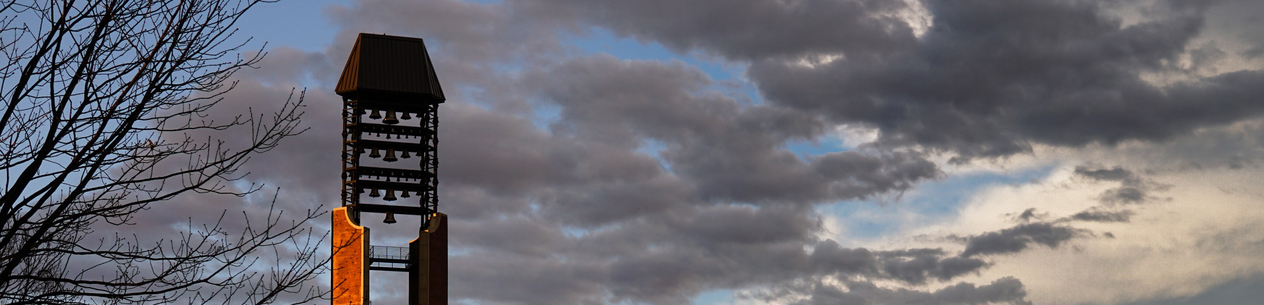
Thank you

